Slide 1
2
God Stirs up the Builders' Hearts

Slide 2
DATE
EVENTS
PROPHETS/BOOKS
WORLD
721 BC
Fall of Northern Kingdom to Assyria
Obadiah
Zephaniah
Nahum
Habakkuk
Israel carried off into diff. foreign lands by Assyria
Assyria destroyed by Babylonians
Babylonian Empire established
587 BC
Fall of Jerusalem and Southern Kingdom to Nebuchadnezzar Il of Babylon
70 years of captivity
Jeremiah
Lamentations
Ezekiel
Daniel
Judah in Babylonian captivity
Rise of Daniel to prominence
Babylon defeated by Medes and Persians

Slide 3
¹ Now in the first year of Cyrus king of Persia, in order to fulfill the word of the Lord by the mouth of Jeremiah, the Lord stirred up the spirit of Cyrus king of Persia, so that he sent a proclamation throughout all his kingdom, and also put it in writing, saying: ² “Thus says Cyrus king of Persia, ‘The Lord, the God of heaven, has given me all the kingdoms of the earth and He has appointed me to build Him a house in Jerusalem, which is in Judah.
- Ezra 1:1-2

Slide 4
³ Whoever there is among you of all His people, may his God be with him! Let him go up to Jerusalem which is in Judah and rebuild the house of the Lord, the God of Israel; He is the God who is in Jerusalem. ⁴ Every survivor, at whatever place he may live, let the men of that place support him with silver and gold, with goods and cattle, together with a freewill offering for the house of God which is in Jerusalem.’”
- Ezra 1:3-4

Slide 5
⁵ Then the heads of fathers’ households of Judah and Benjamin and the priests and the Levites arose, even everyone whose spirit God had stirred to go up and rebuild the house of the Lord which is in Jerusalem. ⁶ All those about them encouraged them with articles of silver, with gold, with goods, with cattle and with valuables, aside from all that was given as a freewill offering.
- Ezra 1:5-6

Slide 6
⁷ Also King Cyrus brought out the articles of the house of the Lord, which Nebuchadnezzar had carried away from Jerusalem and put in the house of his gods; ⁸ and Cyrus, king of Persia, had them brought out by the hand of Mithredath the treasurer, and he counted them out to Sheshbazzar, the prince of Judah
- Ezra 1:7-8

Slide 7
⁹ Now this was their number: 30 gold dishes, 1,000 silver dishes, 29 duplicates; ¹⁰ 30 gold bowls, 410 silver bowls of a second kind and 1,000 other articles. ¹¹ All the articles of gold and silver numbered 5,400. Sheshbazzar brought them all up with the exiles who went up from Babylon to Jerusalem.
- Ezra 1:9-11

Slide 8
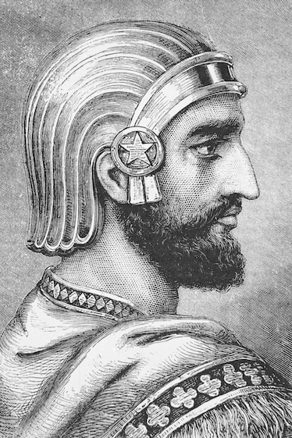
CYRUS
KING OF PERSIA
538 BC
© National Geographic

Slide 9
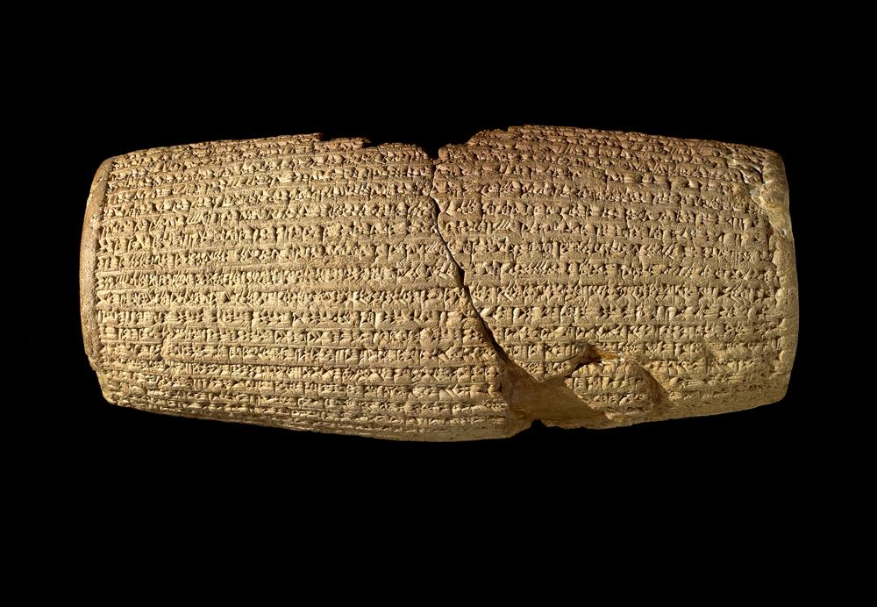
CYRUS CYLINDER
© British Museum

Slide 10
HENOTHEISM
{
BELIEVE IN MANY GODS
WORSHIP ONLY ONE

Slide 11
Conditions
All who wanted to leave, could.
Those remaining to provide funds for those leaving.
Cyrus donates gold and silver

Slide 12
Now these are the people of the province who came up out of the captivity of the exiles whom Nebuchadnezzar the king of Babylon had carried away to Babylon, and returned to Jerusalem and Judah, each to his city.
- Ezra 2:1

Slide 13
These came with Zerubbabel, Jeshua, Nehemiah, Seraiah, Reelaiah, Mordecai, Bilshan, Mispar, Bigvai, Rehum and Baanah.
- Ezra 2:2

Slide 14
¹⁰ “For thus says the Lord, ‘When seventy years have been completed for Babylon, I will visit you and fulfill My good word to you, to bring you back to this place. ¹¹ For I know the plans that I have for you,’ declares the Lord, ‘plans for welfare and not for calamity to give you a future and a hope.
- Jeremiah 29:10-11

Slide 15
¹² Then you will call upon Me and come and pray to Me, and I will listen to you. ¹³ You will seek Me and find Me when you search for Me with all your heart.
- Jeremiah 29:12-13

Slide 16
I will be found by you,’ declares the Lord, ‘and I will restore your fortunes and will gather you from all the nations and from all the places where I have driven you,’ declares the Lord, ‘and I will bring you back to the place from where I sent you into exile.’
- Jeremiah 29:14

Slide 17
“It is I who says of Cyrus, ‘He is My shepherd!
And he will perform all My desire.’
And he declares of Jerusalem, ‘She will be built,’
And of the temple, ‘Your foundation will be laid.’”
- Isaiah 44:28

Slide 18
These came with Zerubbabel, Jeshua, Nehemiah, Seraiah, Reelaiah, Mordecai, Bilshan, Mispar, Bigvai, Rehum and Baanah.
- Ezra 2:2

Slide 19
³⁶ The priests: the sons of Jedaiah of the house of Jeshua, 973;
³⁷ the sons of Immer, 1,052;
³⁸ the sons of Pashhur, 1,247;
³⁹ the sons of Harim, 1,017.
- Ezra 2:36-39

Slide 20
The sons of Solomon’s servants:
- Ezra 2:55a

Slide 21
Of the sons of the priests: the sons of Habaiah, the sons of Hakkoz, the sons of Barzillai, who took a wife from the daughters of Barzillai the Gileadite, and he was called by their name.
- Ezra 2:61

Slide 22
⁶¹ Of the sons of the priests: the sons of Habaiah, the sons of Hakkoz, the sons of Barzillai, who took a wife from the daughters of Barzillai the Gileadite, and he was called by their name. ⁶² These searched among their ancestral registration, but they could not be located; therefore they were considered unclean and excluded from the priesthood. ⁶³ The governor said to them that they should not eat from the most holy things until a priest stood up with Urim and Thummim.
- Ezra 2:61-63

Slide 23
NO GENEALOGICAL RECORDS = PRIESTS

Slide 24
70 AD
Destruction of Jerusalem
Destruction of the people
Destruction of the Temple
Destruction of the genealogical records
Destruction of the Jewish priesthood

Slide 25
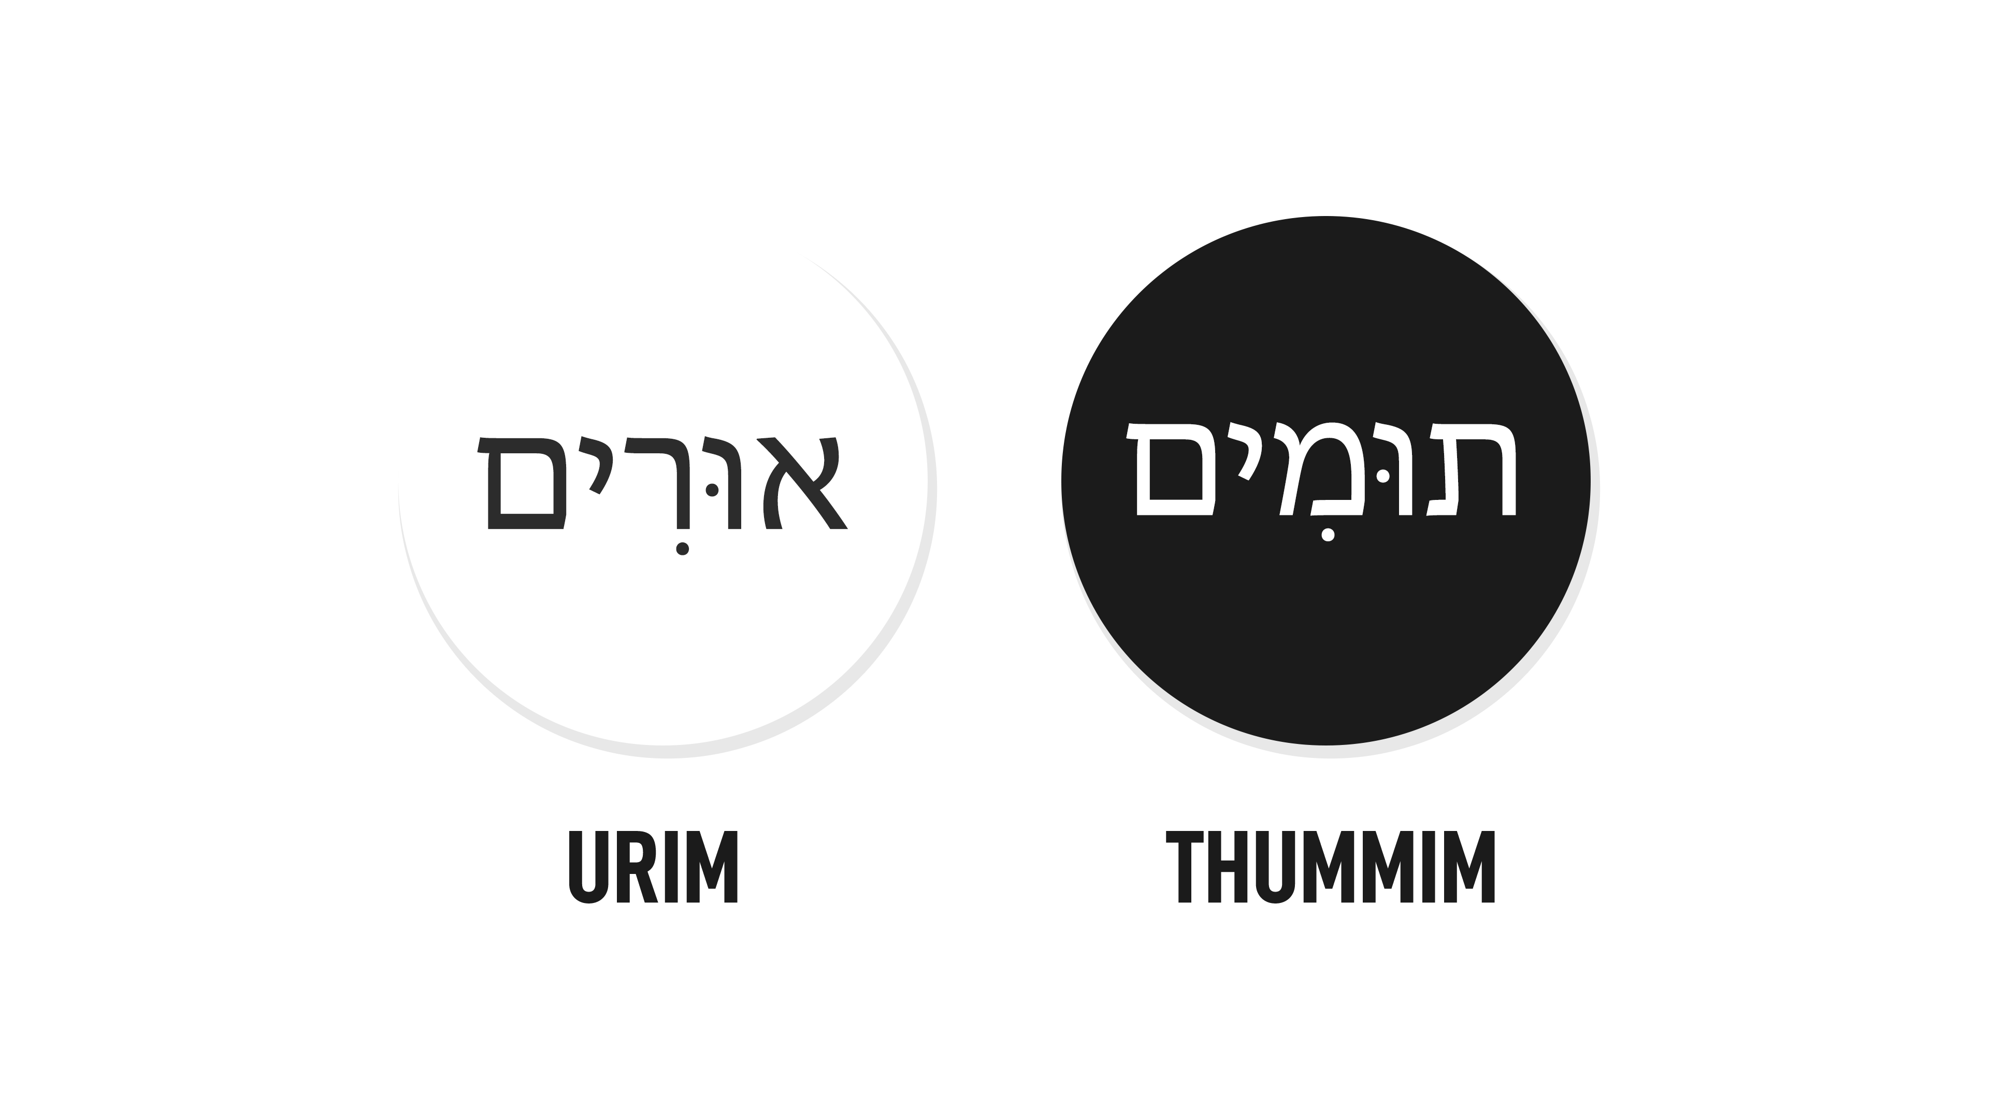

Slide 26
⁶⁸ Some of the heads of fathers’ households, when they arrived at the house of the Lord which is in Jerusalem, offered willingly for the house of God to restore it on its foundation. ⁶⁹ According to their ability they gave to the treasury for the work 61,000 gold drachmas and 5,000 silver minas and 100 priestly garments.
- Ezra 2:68-69

Slide 27
Lessons
God can stir anyone’s heart.

Slide 28
Lessons
God can stir anyone’s heart.
God doesn’t force us to respond to Him.

Slide 29
Lessons
God can stir anyone’s heart.
God doesn’t force us to respond to Him.
God can bless His people anywhere.

Slide 30
If you respond to God in faith and obedience: He will build for you and through you to His glory forever!

