Slide 1
Graduating with Honor

Slide 2
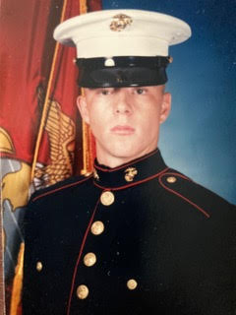
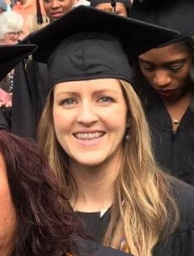
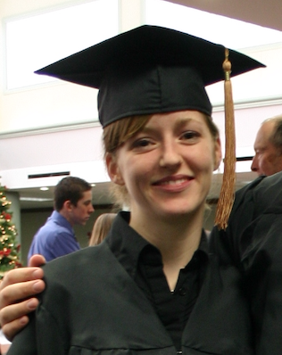
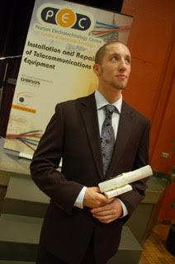

Slide 4
It is a trustworthy statement: For if we died with Him, we will also live with Him; If we endure, we will also reign with Him;
- II Timothy 2:11-12a

Slide 5
Graduating with Honor Before God
You must honor your parents
Children, obey your parents in the Lord, for this is right. Honor your father and mother (which is the first commandment with a promise), so that it may be well with you, and that you may live long on the earth.
- Ephesians 6:1-3

Slide 6
Honor Requires:
Acknowledgement
Reflection
Love
Pray

Slide 7
Graduating with Honor Before God
Honor yourselves
Flee immorality. Every other sin that a man commits is outside the body, but the immoral man sins against his own body. Or do you not know that your body is a temple of the Holy Spirit who is in you, whom you have from God, and that you are not your own? - I Corinthians 6:18-19

Slide 8
For you have been bought with a price: therefore glorify God in your body.
- I Corinthians 6:20

Slide 9
Your body and spirit belong to God.
You use your body. You don’t own your body.

Slide 10
Graduating with Honor Before God
You must honor your parents
Honor yourselves
Honor your Lord
Therefore everyone who confesses Me before men, I will also confess him before My Father who is in heaven. - Matthew 10:32

Slide 11
Your entire life is a confession of Christ.

Slide 12
Honoring Christ Requires:
Faithfulness to His Teaching (Bible)
Faithfulness to His People (Church)
Faithfulness to His Promise (Salvation)

Slide 13
Honoring Students
(CPA CALCULATOR)
CUM LAUDE = Honor = 3.5 - 3.7 GPA
MAGNA CUM LAUDE = Great Honor = 3.8 - 3.9 GPA
SUMMA CUM LAUDE = Greatest Honor = 3.96 - 4+ GPA

Slide 14
Then I looked, and behold, the Lamb was standing on Mount Zion, and with Him one hundred and forty-four thousand, having His name and the name of His Father written on their foreheads.
- Revelation 14:1

Slide 15
Peter said to them, “Repent, and each of you be baptized in the name of Jesus Christ for the forgiveness of your sins; and you will receive the gift of the Holy Spirit.
- Acts 2:38

Slide 16
Graduate with honor before God today!

