Slide 1
1
Introduction

Slide 2
MAJOR PROPHETS Average 46 chapters MINOR PROPHETS Average 6 chapters

Slide 3
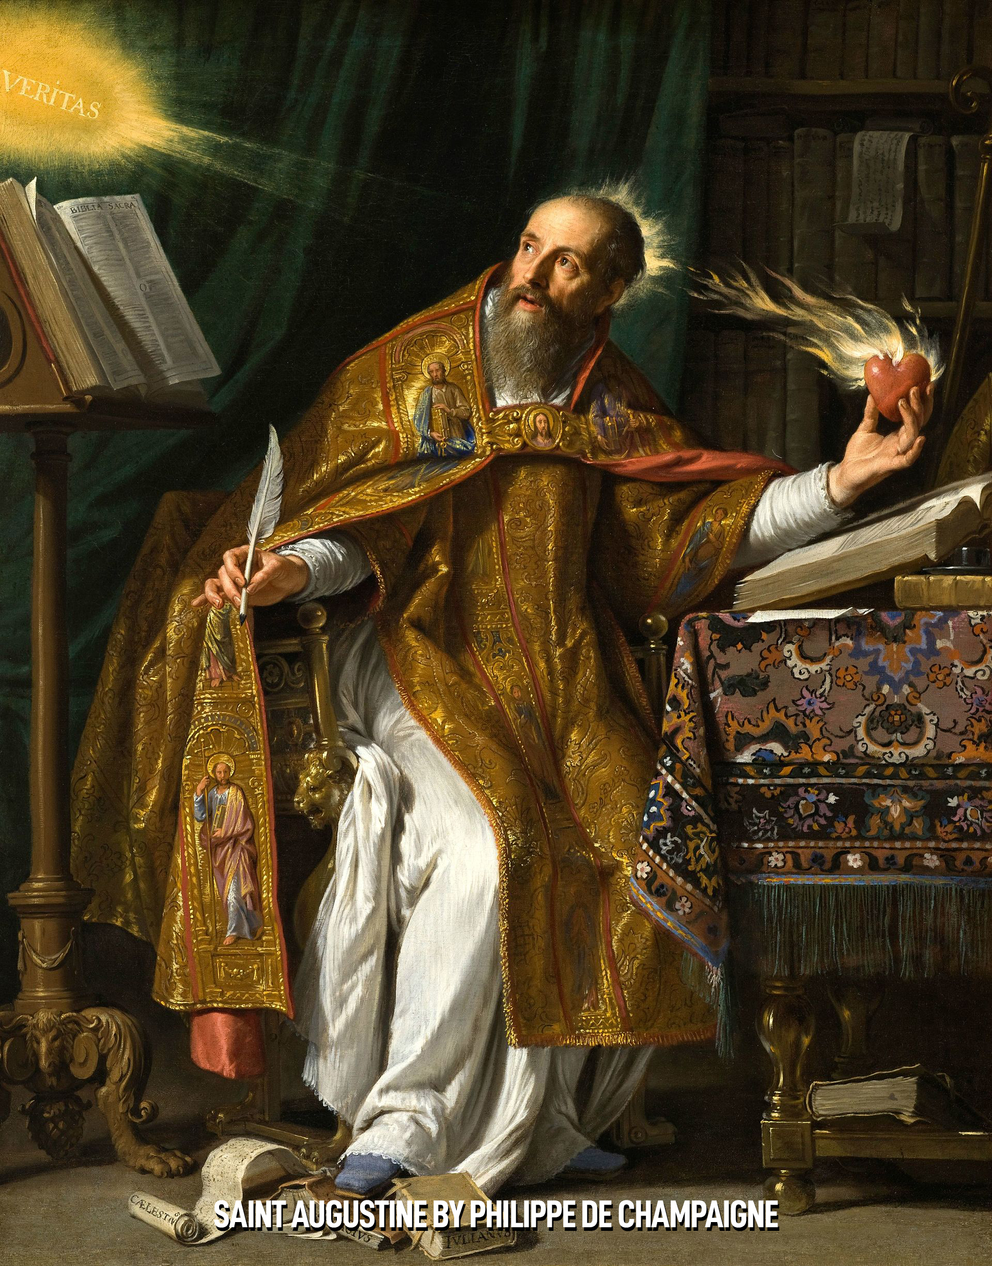

Slide 4
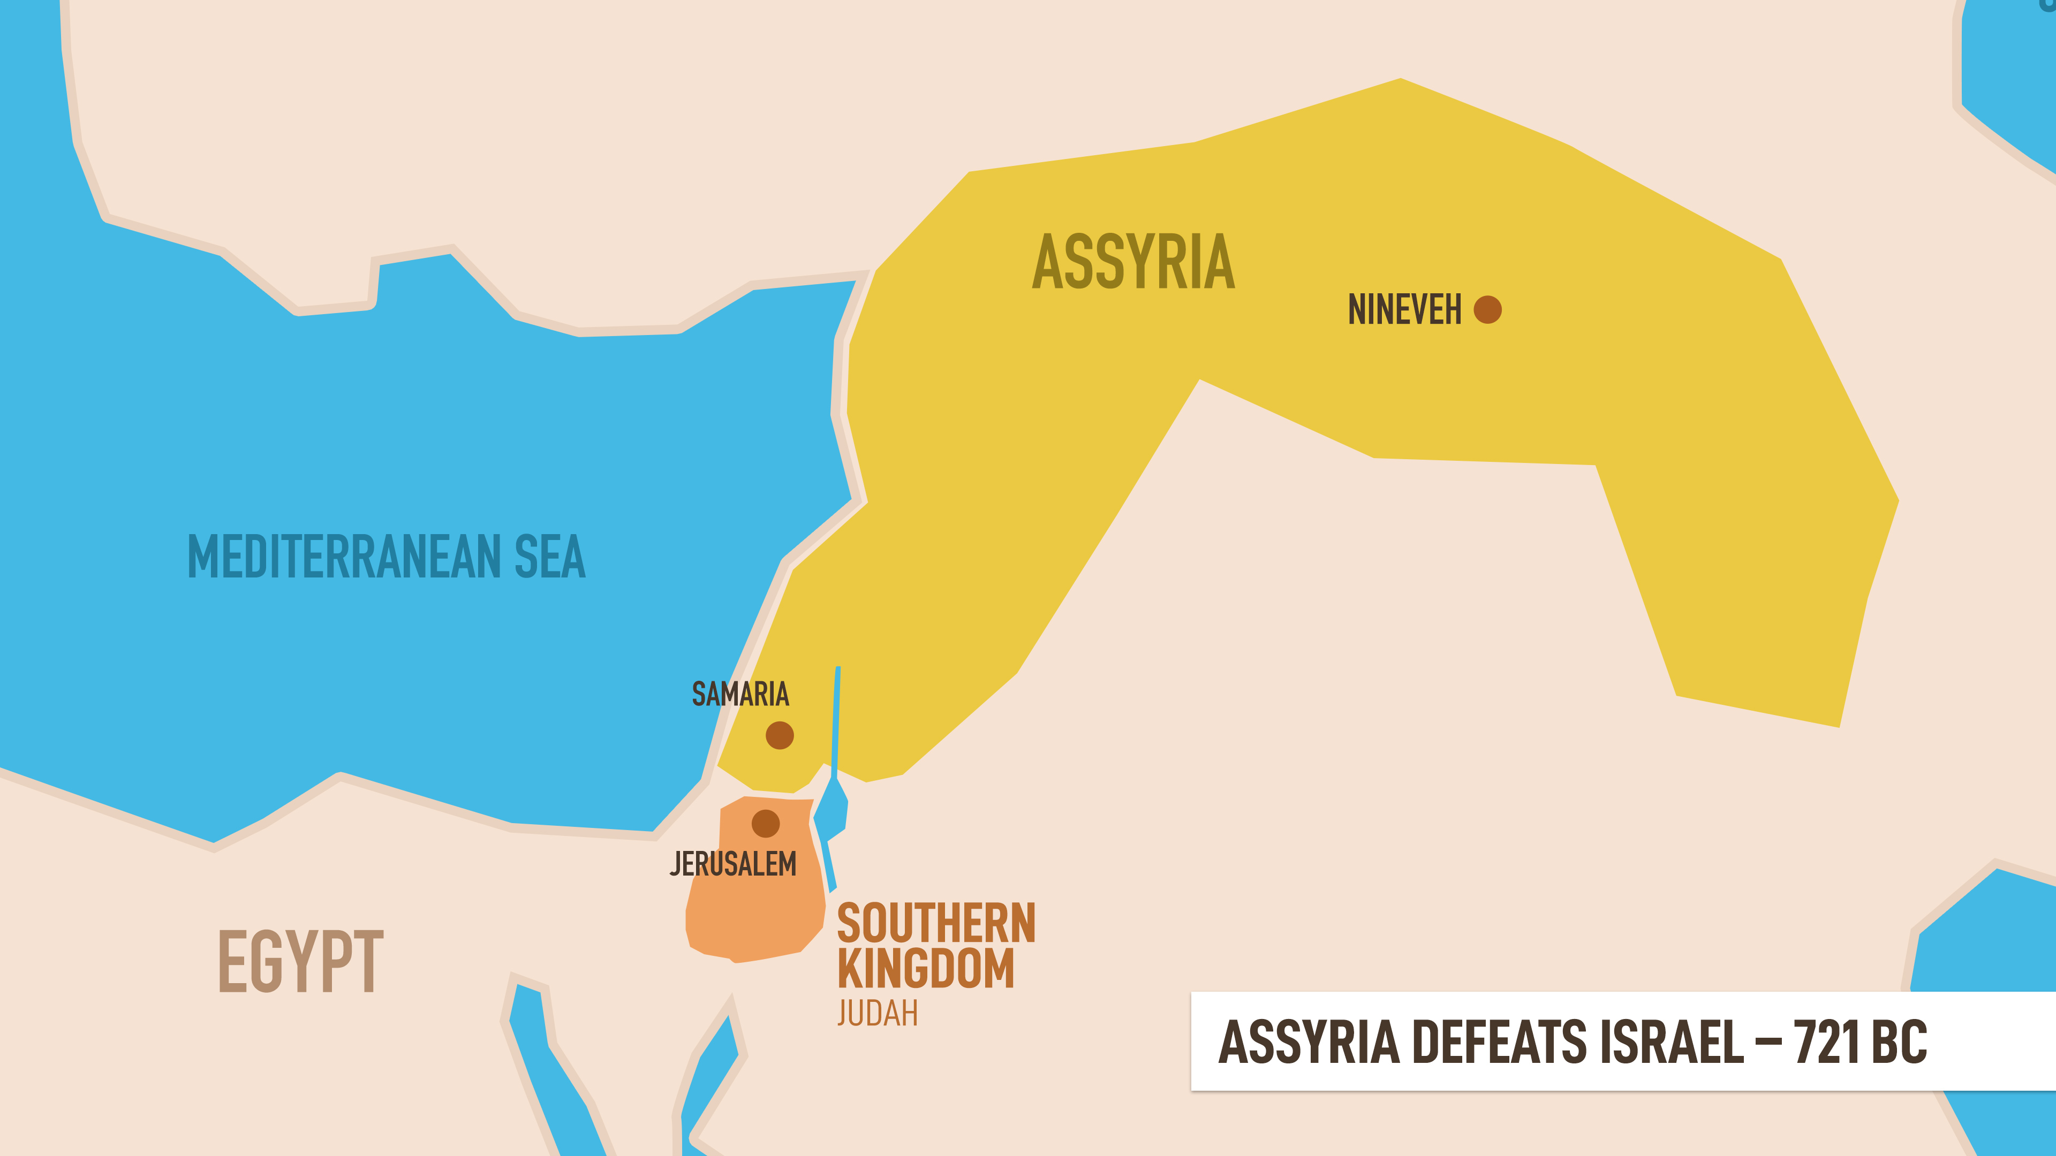

Slide 5
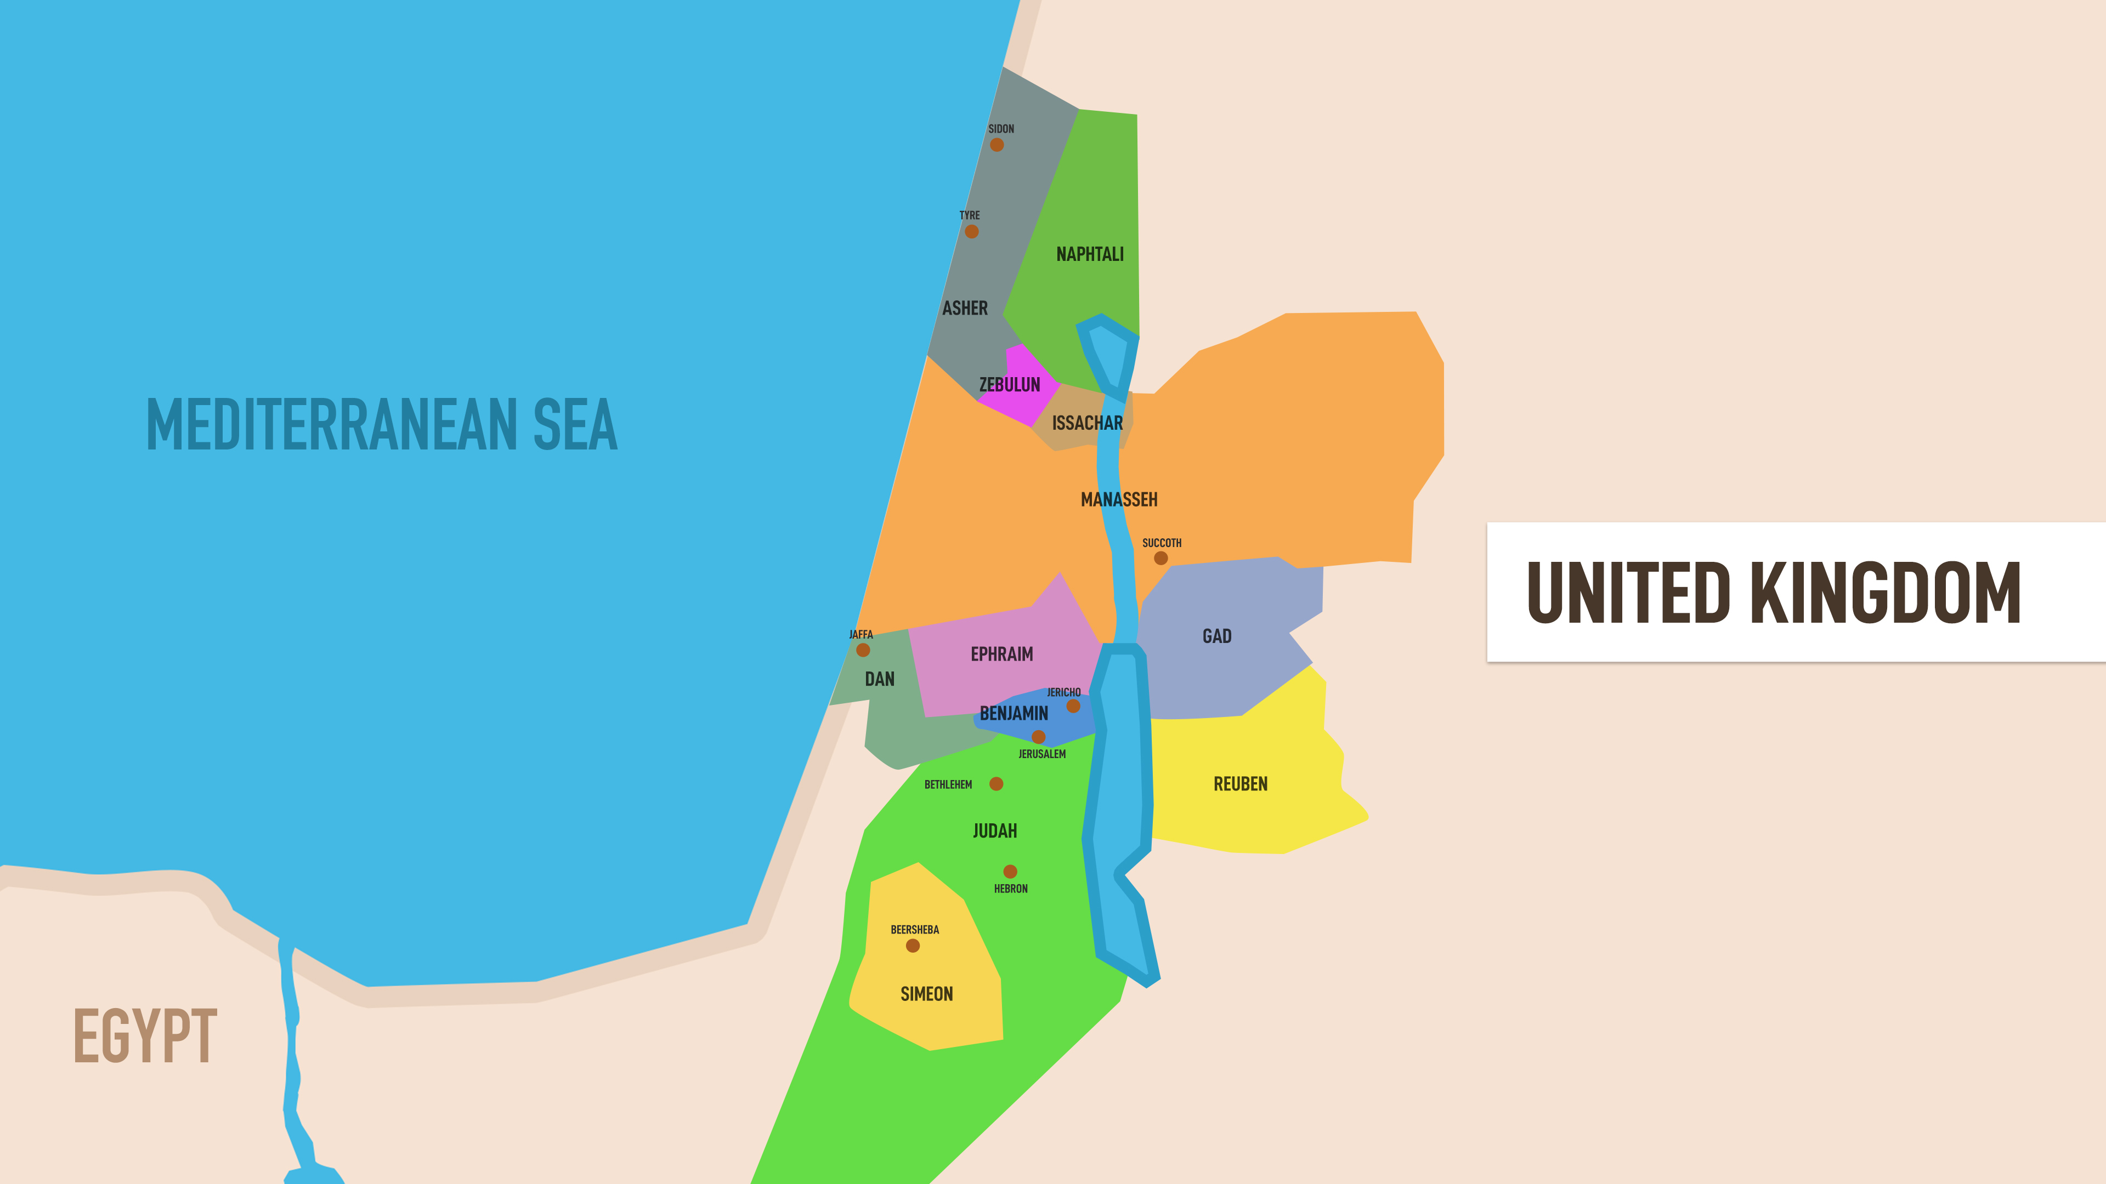

Slide 6
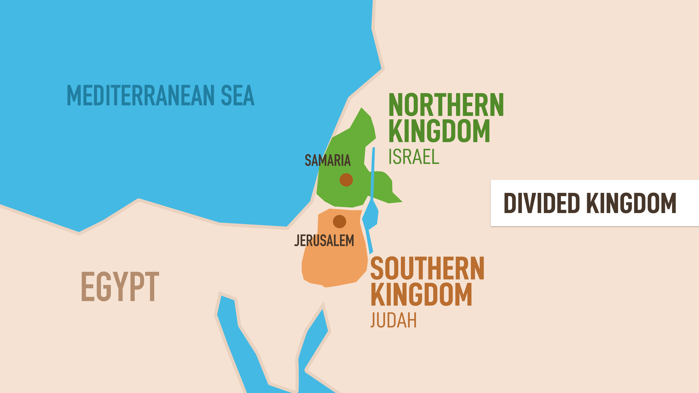

Slide 7
10 Lost Tribes – Samaritans
Remnant of Northern Kingdom
Mixed racially and religiously
Despised by Jews
Samaria

Slide 8
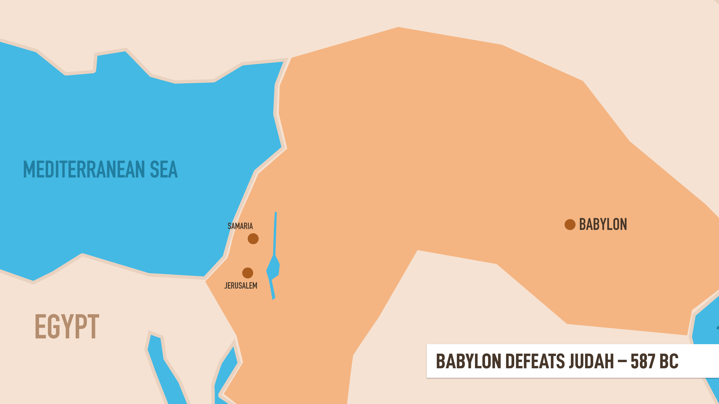

Slide 9
Exiles
Best of society carried off to Babylon
Re-educated and trained to serve (i.e. Daniel)
Preserved their cultural and religious purity

Slide 10
‘Then it will be when seventy years are completed I will punish the king of Babylon and that nation,’ declares the Lord, ‘for their iniquity, and the land of the Chaldeans; and I will make it an everlasting desolation.
- Jeremiah 25:12

Slide 11
Exiles
Best of society carried off to Babylon
Re-educated and trained to serve (i.e. Daniel)
Preserved their cultural and religious purity
They were able to reestablish both their society and Temple worship according to God’s Law

Slide 12
ORGANIZATION OF THE CANON (INSPIRED BOOKS) WIKIPEDIA – THE 12 MINOR PROPHETS
A. The Hebrew Bible – Judaism
TORAH – INSTRUCTION
Gen., Ex., Lev., Num., Deut.
KETUVIM – THE WRITINGS
Poetic: Psalms, Proverbs, Job
5 Megillot – Scrolls: Song of Songs, Ruth, Lamentations, Ecclesiastes, Esther
Historical Daniel, Ezra/Nehemiah, Chronicles
NEVI’IM – PROPHETS
Former: Joshua, Judges, Samuel, Kings
Latter: Isaiah, Jeremiah, Ezekiel
Minor (Grouped in Single Book):
Hosea, Joel, Amos, Obadiah, Jonah, Micah, Nahum, Habakkuk, Zephaniah, Haggai, Zechariah, Malachi
TOTAL: 24 BOOKS

Slide 13
ORGANIZATION OF THE CANON (INSPIRED BOOKS)
B. The Old Testament – Christianity
PENTATEUCH
Gen., Ex., Lev., Num., Deut.
PROPHETIC
MAJOR: Isaiah, Jeremiah, Lamentations, Ezekiel, Daniel
MINOR:
Hosea, Joel, Amos, Obadiah, Jonah, Micah, Nahum, Habakkuk, Zephaniah, Haggai, Zechariah, Malachi
HISTORICAL
Joshua, Judges, Ruth, I & II Samuel I & II Kings, I & II Chronicles, Ezra,
Nehemiah, Esther
WISDOM
Job, Psalms, Proverbs, Ecclesiastes, Song of Solomon
TOTAL: 39 BOOKS

Slide 14
ORGANIZATION OF THE CANON (INSPIRED BOOKS)
C. Deuterocanonical I
Books considered canonical (inspired) by Roman Catholics; Eastern Orthodox, Oriental Orthodox; Assyrian Orthodox –
But not Jewish, Protestant or Restoration (Church of Christ) Churches.
Tobit, Judith, Additions to Esther, I & II Maccabees
Wisdom of Solomon
Sirach, Baruch, Letter of Jeremiah, Additions to Daniel

Slide 15
ORGANIZATION OF THE CANON (INSPIRED BOOKS)
D. Deuterocanonical II
Books considered canonical (inspired) by only the Orthodox Churches.
I & II Esdras, Prayer of Manasseh, Psalm 151, III & IV Maccabees, Odes

Slide 16
Additional Books
Deuterocanonical – Apocrypha (hidden)
Canon = Measure
Not included because:
No Apostolic Authorship
Errors
Shallow spiritual content
Official Old Testament Canon: 150 BC

Slide 17
Minor Prophets – Timeline
Fall of Northern Kingdom – 721 BC
Hosea, Joel, Amos
Obadiah, Jonah, Micah
Fall of Southern Kingdom – 587 BC
Nahum, Habakkuk, Zephaniah
Return of Exiles – 538-457 BC
Haggai, Zechariah, Malachi

Slide 18
Minor Prophet Series
Not line-by-line
Summary of content
History
Features
Author
Message
Lessons

Slide 19
Hosea and Joel

