Slide 1
The Act of Marriage
MIKE MAZZALONGO /
GENESIS 1:27-28; 2:24-25

Slide 2
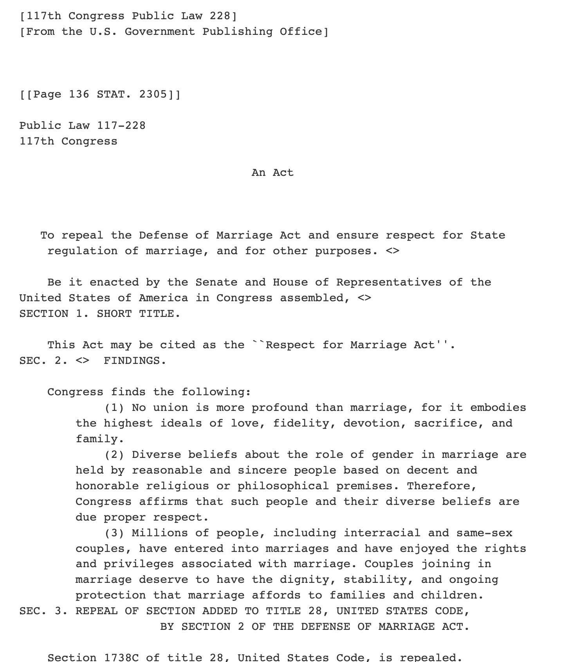
Bill H.R.8404 - Respect for Marriage Act

Slide 3
“…that recognize any marriage between two individuals that is valid under state law.”

Slide 4
There is also protection for religious groups’ rights under conscience of religion which include the right not to participate, recognize or celebrate such marriages.

Slide 5
The Act of Marriage (Between a Man + Woman)
Biblical marriage is a symbol of the highest commitment of love expressed in law.

Slide 6
Co-Habitation has been “Normalized”
1970 – ½ of 1% - Cohabitate
2021 – 15% - Cohabitate

Slide 7
DON’T CONFUSE: Normalization with Legitimization

Slide 8
History
{
Traditional Legal Marriage
Secular History 4,350 years
Biblical History 6,000 years

Slide 10
Break from traditional biblical marriage led to demise of society within three generations. - Sex and Culture

Slide 11
The Act of Marriage (Between a Man + Woman)
Biblical marriage is a symbol of the highest commitment of love expressed in law.
Creates a union that most resembles the nature of God.

Slide 12
God and Male/Female Marriages
Both have a dynamic nature
God – Triune
Marriage – Two become one

Slide 13
God and Male/Female Marriages
Both have a dynamic nature
Both have “creative ability”
God – What is seen from the unseen (Hebrews 11:3)
Marriage – Procreation (Genesis 1:28)

Slide 14
God and Male/Female Marriages
Both have a dynamic nature
Both have “creative ability”
Both are holy
God by nature
Marriage by obedience

Slide 15
For cohabitating couples:
Intimacy is sinful.
Fidelity has no cost.
Self-sacrifice is to please partner, not God.
Roles are without context if you are not married.

Slide 16
For same-sex couples:
Intimacy is sinful (Leviticus 18:22)
Fidelity and self-sacrifice to please partner.
Roles are illegitimate (Genesis 2:18-25) – Men cannot be wives and women cannot be husbands.

Slide 17
You shall not lie with a male as one lies with a female; it is an abomination.
- Leviticus 18:22

Slide 18
Or do you not know that the unrighteous will not inherit the kingdom of God? Do not be deceived; neither fornicators, nor idolaters, nor adulterers, nor effeminate, nor homosexuals, nor thieves, nor the covetous, nor drunkards, nor revilers, nor swindlers, will inherit the kingdom of God.
- I Corinthians 6:9-10

Slide 19
What to do?
Understand the reality before us
Co-habs
Same-sex

Slide 20
Without God’s blessing (from the Bible) no union can succeed on a spiritual level.

Slide 21
For we must all appear before the judgment seat of Christ, so that each one may be recompensed for his deeds in the body, according to what he has done, whether good or bad.
- II Corinthians 5:10

Slide 22
Same-sex Unions:
No dynamic spiritual nature
No natural creative ability
No holiness because of sin

Slide 23
What to do?
Understand reality from God’s perspective
Take Romans 6:23a seriously!

Slide 24
For the wages of sin is death,
- Romans 6:23a

Slide 25
Romans 6:23a is literal!

Slide 26
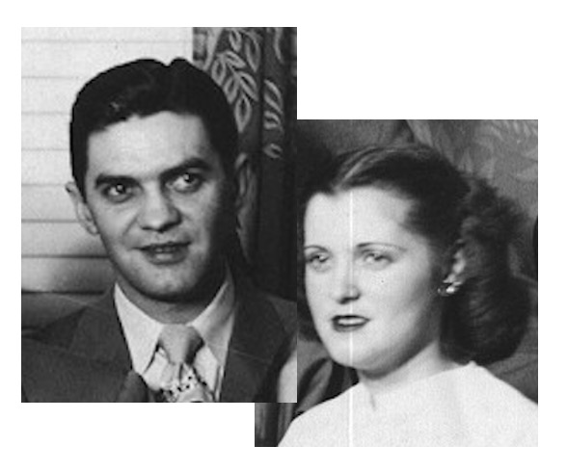

Slide 27
God is serious about sin and its power to destroy lives.

Slide 28
God never lies.

Slide 29
What to do?
Accept reality

Slide 30
What to do?
Accept reality
Believe God

Slide 31
For the wages of sin is death,
- Romans 6:23a

Slide 32
What to do?
Accept reality
Believe God
Cling to the cross

Slide 33
Just as He chose us in Him before the foundation of the world, that we would be holy and blameless before Him.
- Ephesians 1:4

Slide 34
For the wages of sin is death, but the free gift of God is eternal life in Christ Jesus our Lord.
- Romans 6:23

Slide 35
For I am not ashamed of the gospel, for it is the power of God for salvation to everyone who believes, to the Jew first and also to the Greek.
- Romans 1:16

Slide 36
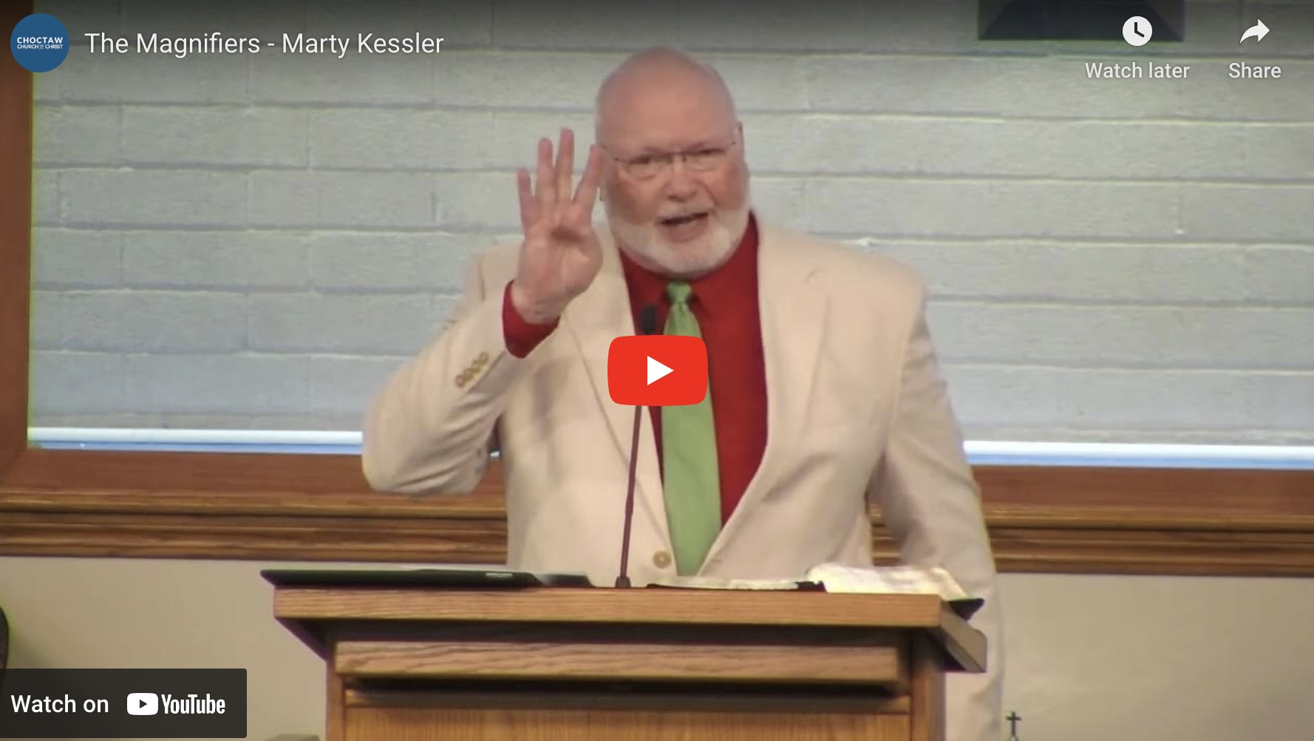
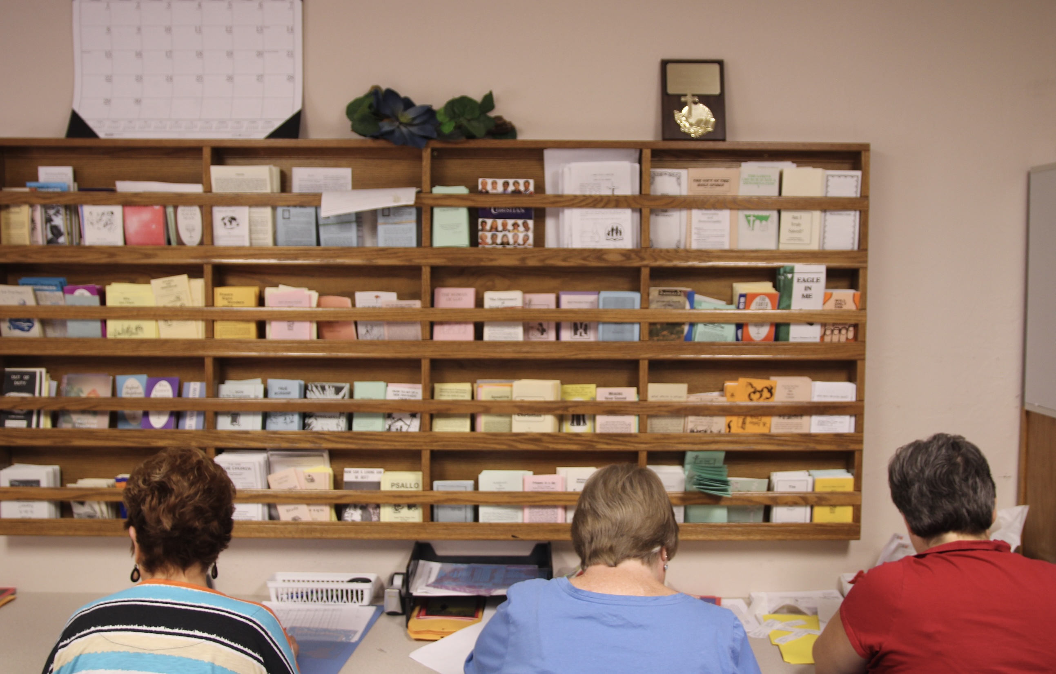
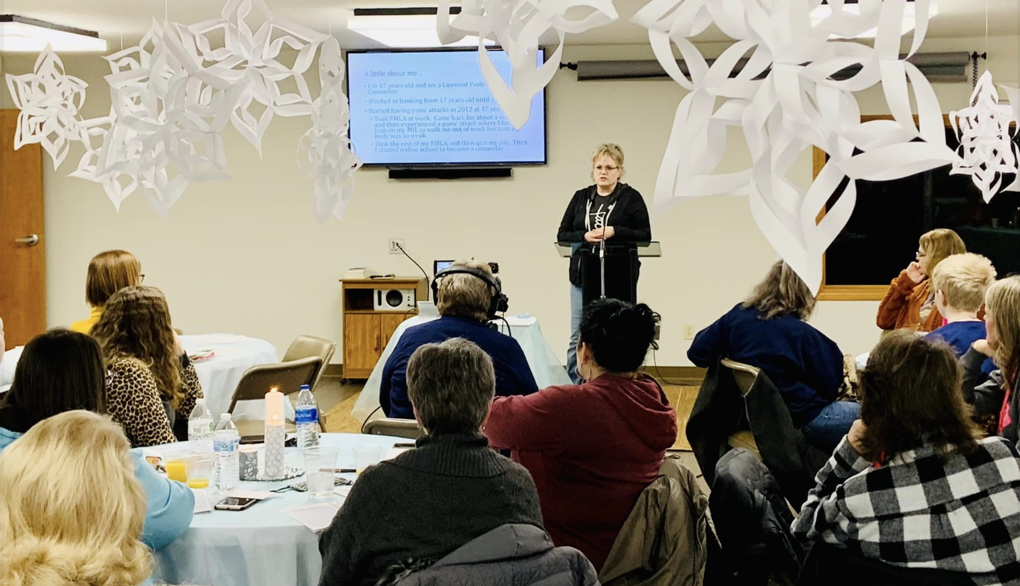
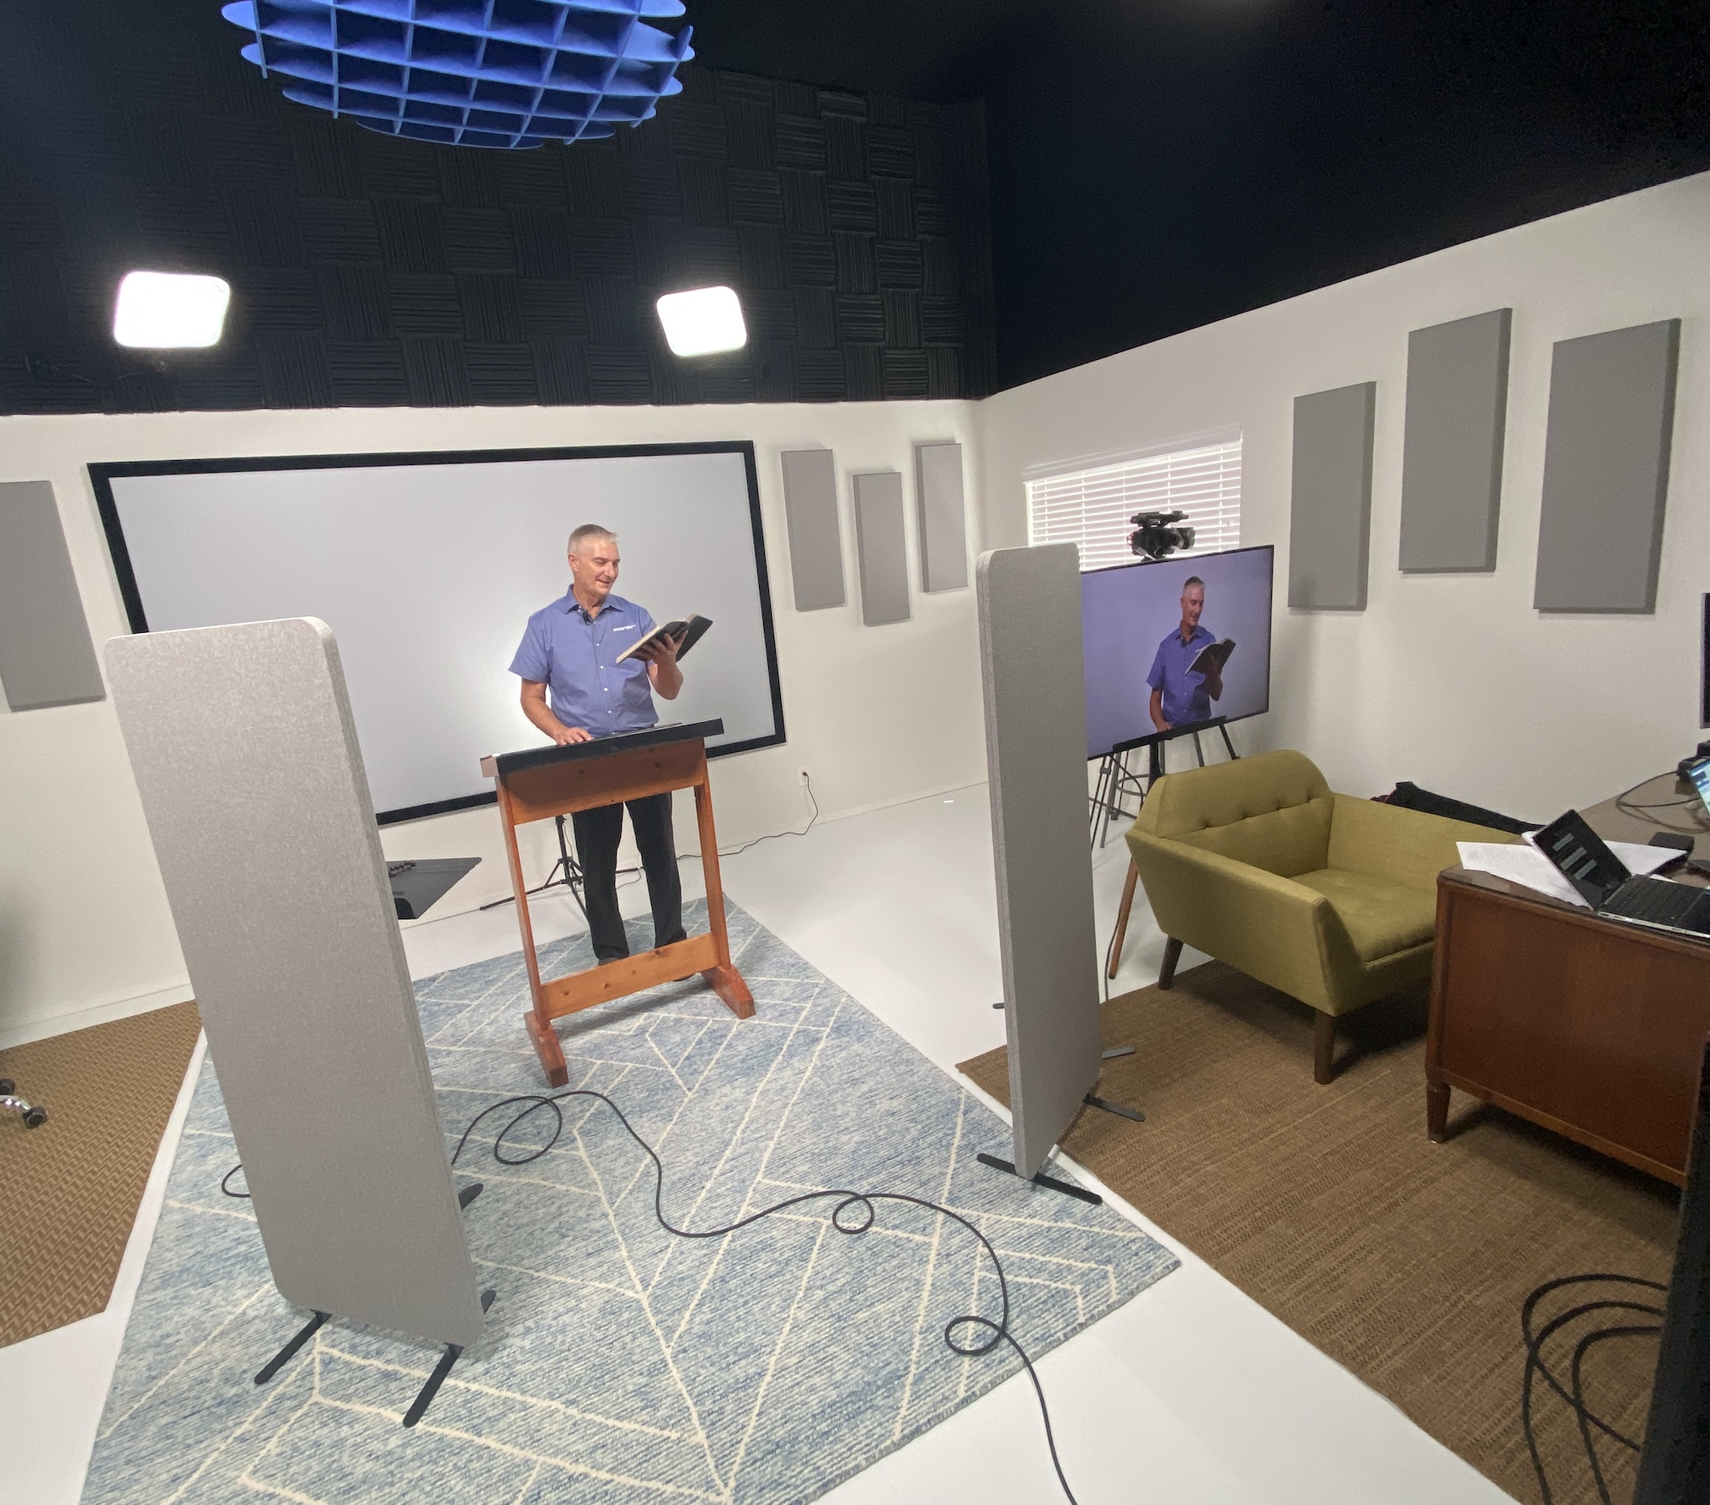
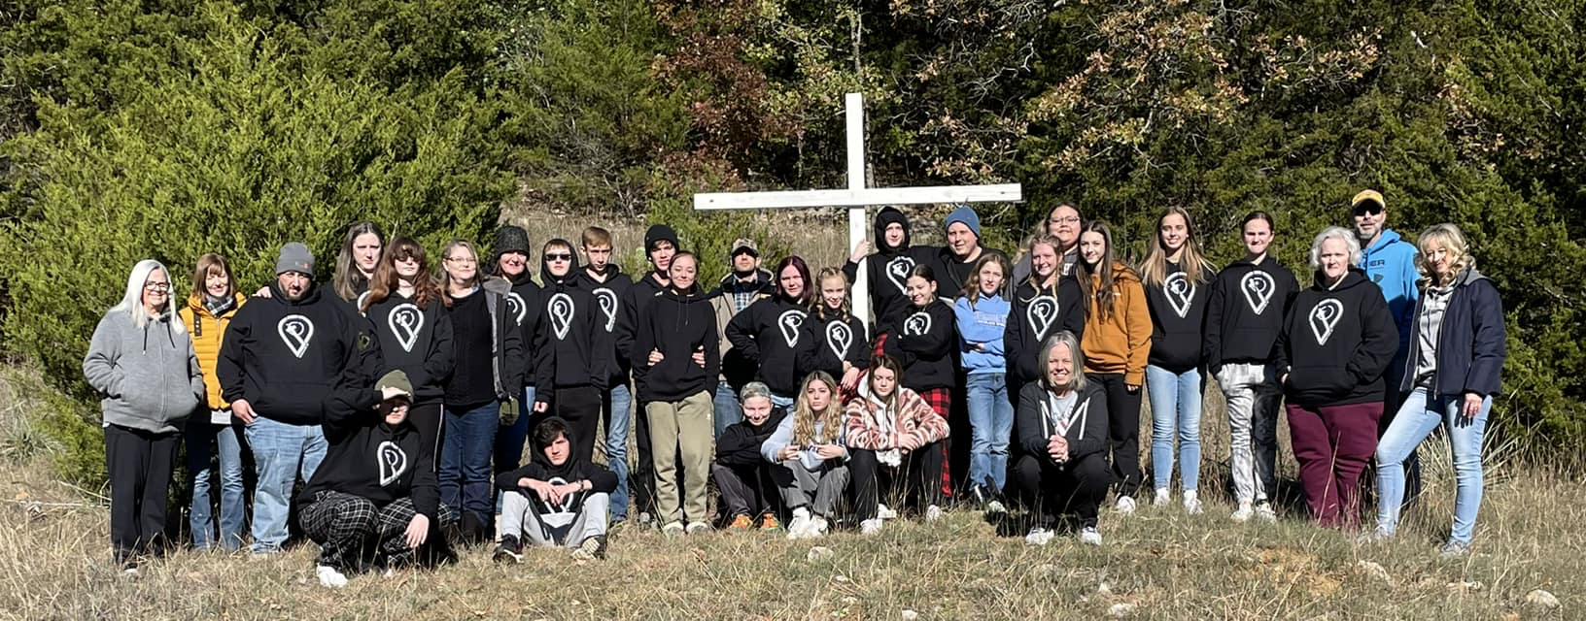
CHOCTAW CHURCH OF CHRIST

Slide 37
Raising up the cross of Christ to a dying world is always the first task of the church.

Slide 38
The Cross Leads and Enables our:
Growth in Holiness
Spiritual Intimacy
Spiritual Fruitfulness
Spiritual Wholeness
}
BEFORE GOD

Slide 39
All of this for those who come, proclaim and cling to the cross of Christ.

Slide 40
How far are you from the cross today?

