Slide 1
The Chocolate Cross
MIKE MAZZALONGO

Slide 2
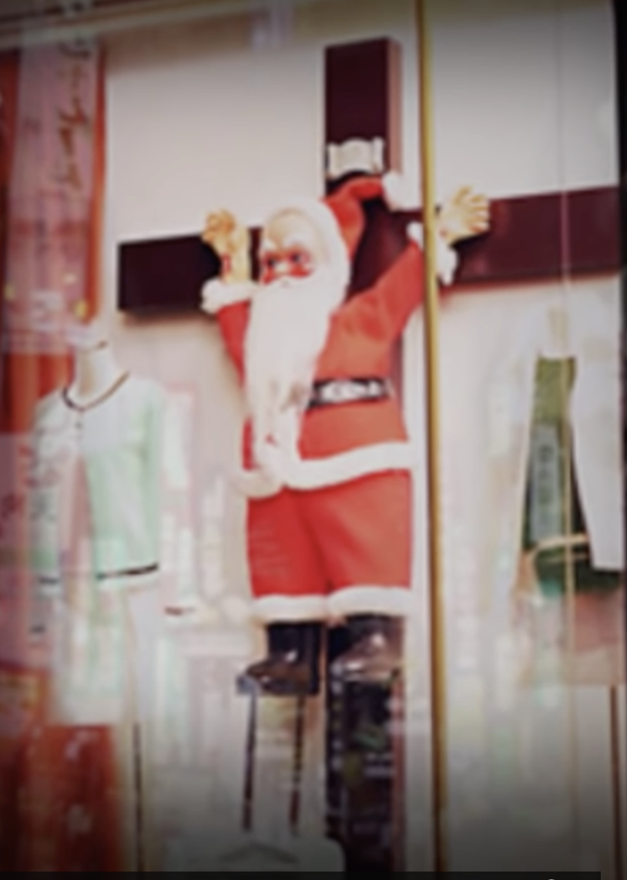

Slide 7
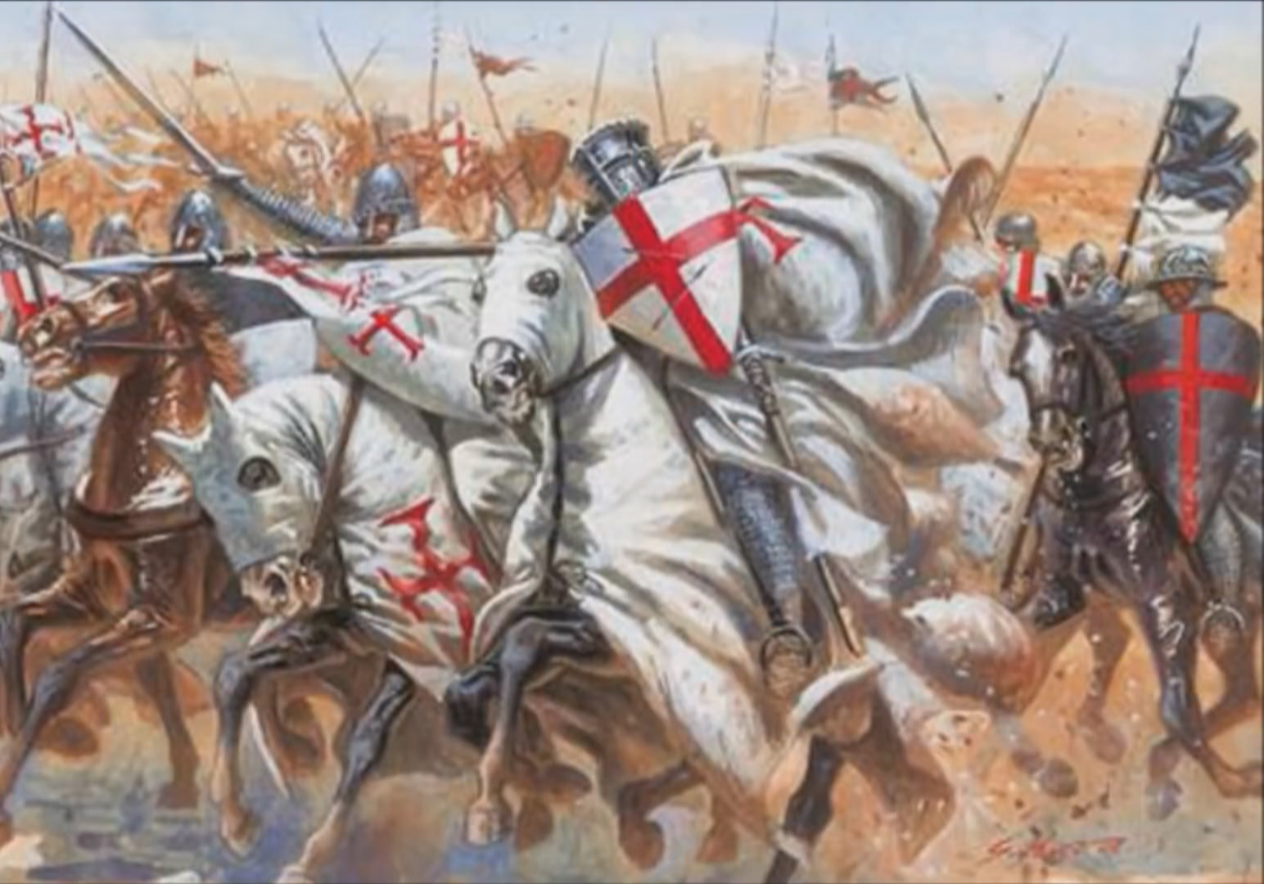

Slide 10
Christians carry the Cross of Christ.

Slide 11
And he who does not take his cross and follow after Me is not worthy of Me.
- Matthew 10:38

Slide 12
Then Jesus said to His disciples, “If anyone wishes to come after Me, he must deny himself, and take up his cross and follow Me.
- Matthew 16:24

Slide 13
²⁵ Now large crowds were going along with Him; and He turned and said to them, ²⁶ “If anyone comes to Me, and does not hate his own father and mother and wife and children and brothers and sisters, yes, and even his own life, he cannot be My disciple.
- Luke 14:25-26

Slide 14
Whoever does not carry his own cross and come after Me cannot be My disciple.
- Luke 14:27

Slide 15
Discipleship = Cross Carrying

Slide 16
⁹ Do not acquire gold, or silver, or copper for your money belts, ¹⁰ or a bag for your journey, or even two coats, or sandals, or a staff; for the worker is worthy of his support.
- Matthew 10:9-10

Slide 17
Whoever does not receive you, nor heed your words, as you go out of that house or that city, shake the dust off your feet.
- Matthew 10:14

Slide 18
Behold, I send you out as sheep in the midst of wolves; so be shrewd as serpents and innocent as doves.
- Matthew 10:16

Slide 19
“Brother will betray brother to death, and a father his child; and children will rise up against parents and cause them to be put to death.
- Matthew 10:21

Slide 20
He who has found his life will lose it, and he who has lost his life for My sake will find it.
- Matthew 10:39

Slide 21
Cross Carrying = Self-Denial

Slide 22
And He was saying to them all, “If anyone wishes to come after Me, he must deny himself, and take up his cross daily and follow Me.
- Luke 9:23

Slide 23
“Whoever does not carry his own cross and come after Me cannot be my disciple.”
- Luke 14:27

Slide 24
So then, none of you can be My disciple who does not give up all his own possessions.
- Luke 14:33

Slide 25
What is Cross Carrying?
An experience that followers of Jesus have.

Slide 26
What is Cross Carrying?
An experience
A common experience shared by all followers.

Slide 27
What is Cross Carrying?
An experience
A common experience
Not pleasant but yielding great spiritual rewards.

Slide 28
What is Cross Carrying?
An experience
A common experience
Difficult but rewarding experience
A daily, on-going experience.

Slide 29
Then Jesus said to His disciples, “If anyone wishes to come after Me, he must deny himself, and take up his cross and follow Me.
- Matthew 16:24

Slide 30
Cross carrying is a metaphor for suffering, therefore:
“Picking up your cross is a reference to the suffering a disciple will experience caused by the practice of denial of self in order to follow Jesus.”

Slide 31
Not all suffering is related to cross carrying.

Slide 32
Denial of Self ↓ is not the same as ↓ Self-Denial

Slide 33
Self-Denial = Self Control Denial of Self = Replacement of self with Christ at the center of self.

Slide 34
WHY – Denial of Self?

Slide 35
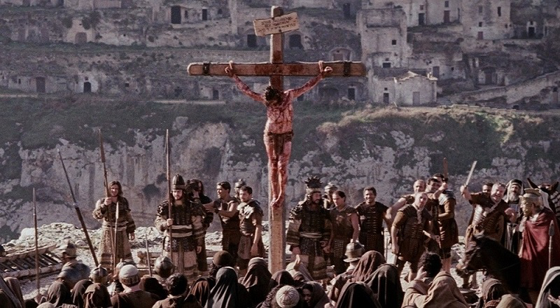

Slide 36
For whoever wishes to save his life will lose it; but whoever loses his life for My sake will find it.
- Matthew 16:25

Slide 37
You pick up your cross at baptism!

Slide 38
“Father, if You are willing, remove this cup from Me; yet not My will, but Yours be done.”
- Luke 22:42

Slide 39
Cross Carrying
No denial of self = No suffering
No suffering = No cross carrying
No cross carrying = No discipleship
No discipleship = No resurrection

Slide 40
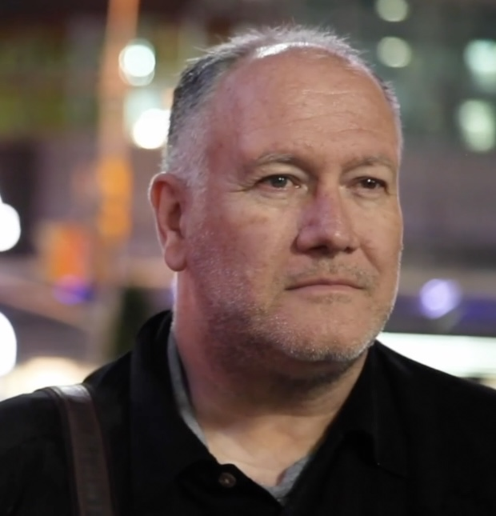

Slide 42
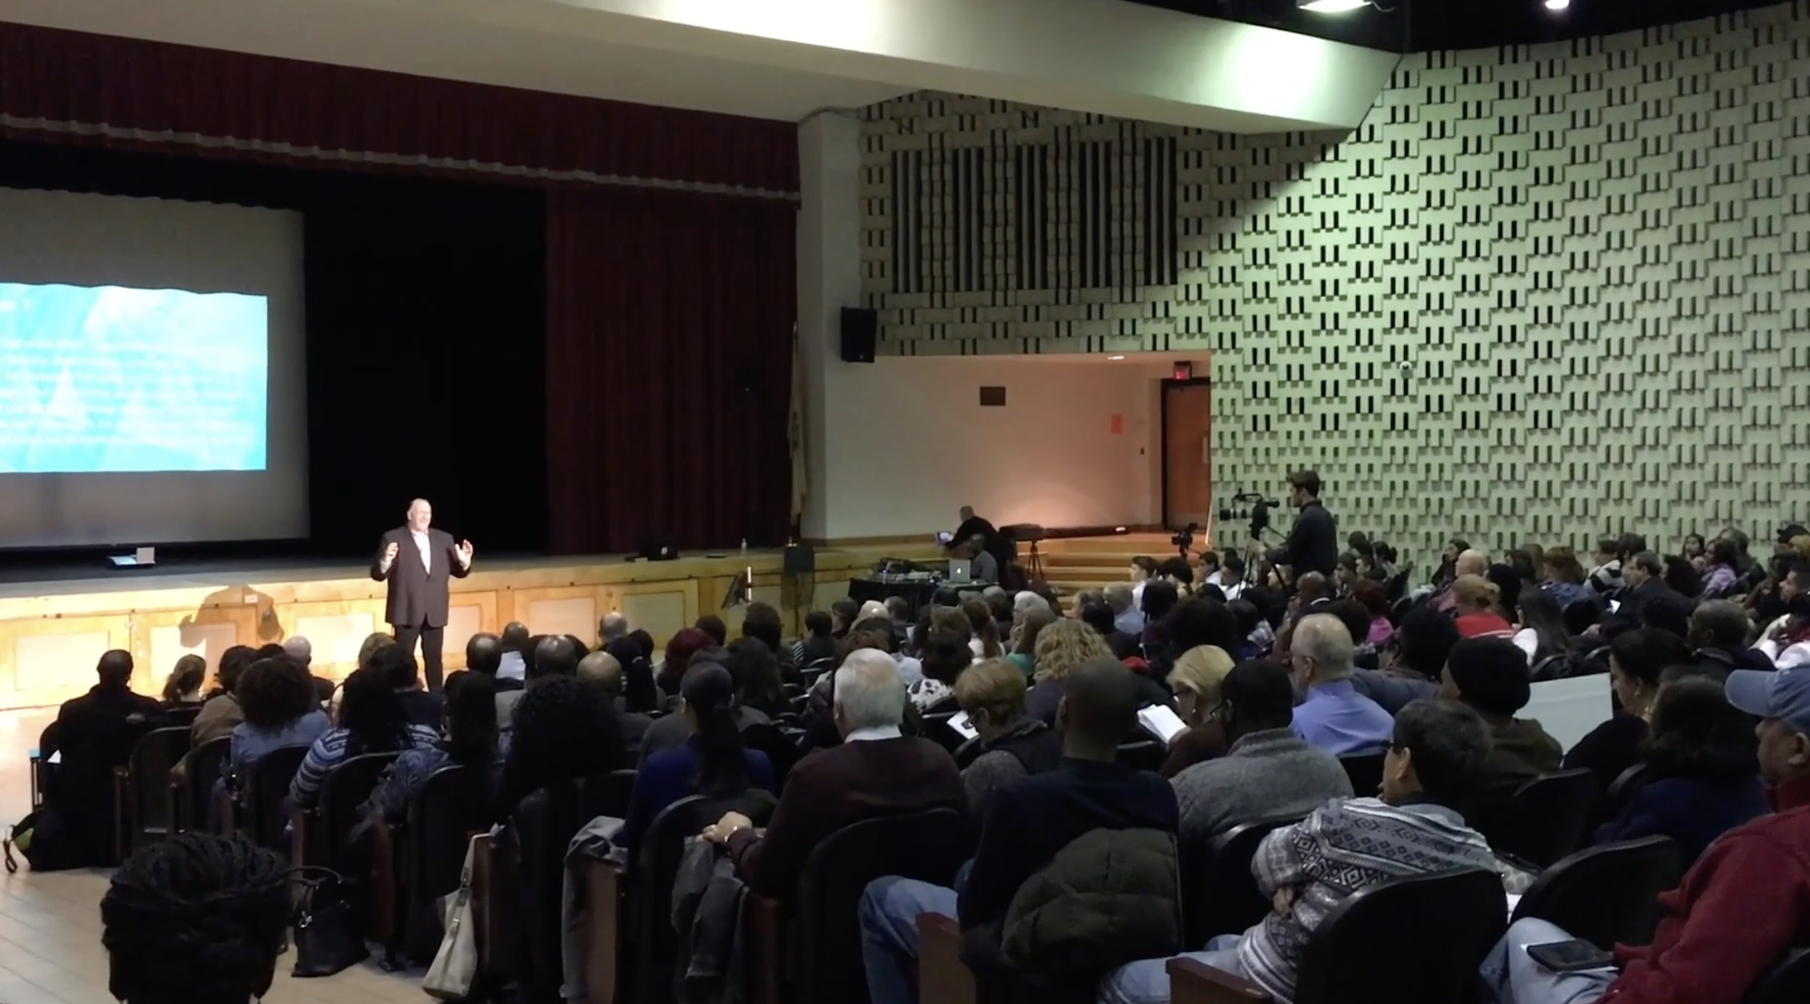

Slide 43
His choice was not between: Homosexuality or Heterosexuality

Slide 44
His choice was between: Homosexuality or Holiness
(felt) (what God wanted)

Slide 45
No Cross ↓ No Resurrection ↓ No Eternal Life

Slide 46
If there’s no cross carrying in this life… There will be no resurrecting to the next life with God.

Slide 47
His resurrection makes mine possible.

Slide 48
Are you ready to pick up your cross today?

Slide 49
²⁴ Then Jesus said to His disciples, “If anyone wishes to come after Me, he must deny himself, and take up his cross and follow Me. ²⁵ For whoever wishes to save his life will lose it; but whoever loses his life for My sake will find it.
- Matthew 16:24-25

Slide 50
Who will follow Jesus today?

