Slide 1
Unity vs. Conformity
MIKE MAZZALONGO / EPHESIANS 4:1-16

Slide 2
CONFORMITY =
Becoming the same

Slide 3


Slide 4
Conformist Advantages
Easier to grow

Slide 5
Conformist Advantages
Easier to grow
Easier to control

Slide 6
Conformist Advantages
Easier to grow
Easier to control
Conformity is comfortable

Slide 7
Conformist Disadvantages
People are not machines

Slide 8
Conformist Disadvantages
People are not machines
Conformity
breeds competition

Slide 9
Conformist Disadvantages
People are not machines
Conformity breeds competition
Conformity is not biblical

Slide 10
UNITY =
The state of being made one

Slide 11
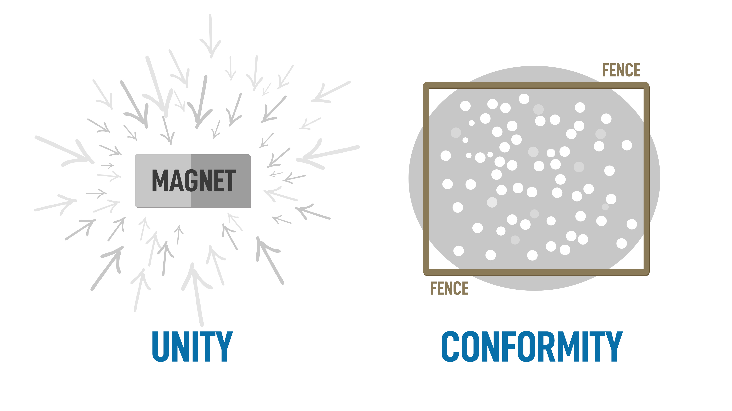

Slide 12
Ephesians 1-3: All that God has done
Planned salvation
Prepared spiritual gifts
Created oneness between
Father – Son – Holy Spirit – Church

Slide 13
#1 PRIORITY =
Preserve Unity

Slide 14
Unity
The call to unity
¹ Therefore I, the prisoner of the Lord, implore you to walk in a manner worthy of the calling with which you have been called, ² with all humility and gentleness, with patience, showing tolerance for one another in love, ³ being diligent to preserve the unity of the Spirit in the bond of peace.
- Ephesians 4:1-3

Slide 15
Paul begins by encouraging the Ephesians to preserve unity and he explains how to do this.

Slide 16
PRESERVING UNITY REQUIRES
Humility
Meekness
Patience
Forbearance

Slide 17
Unity
The call to unity
The basis of unity

Slide 18
CONFORMITY =
Striving for sameness
UNITY =
Experience of sharing

Slide 19
⁴ There is one body and one Spirit, just as also you were called in one hope of your calling; ⁵ one Lord, one faith, one baptism, ⁶ one God and Father of all who is over all and through all and in all.
- Ephesians 4:4-6

Slide 20
We are united because we share:
One Body
One Spirit
One Hope
One Lord
One Faith
One Baptism
One God
}
… the experience of all these things unites us into oneness.

Slide 21
Unity
The call to unity
The basis of unity
God helps us maintain unity

Slide 22
⁷ But to each one of us grace was given according to the measure of Christ’s gift. ⁸ Therefore it says, “When He ascended on high, He led captive a host of captives, And He gave gifts to men.”
- Ephesians 4:7-8

Slide 23
⁹ (Now this expression, “He ascended,” what does it mean except that He also had descended into the lower parts of the earth? ¹⁰ He who descended is Himself also He who ascended far above all the heavens, so that He might fill all things.)
- Ephesians 4:9-10

Slide 24
And He gave some as apostles, and some as prophets, and some as evangelists, and some as pastors and teachers,
- Ephesians 4:11

Slide 25
Each is a gift in two ways:
You have the gift
You receive the gift

Slide 26
Gifts to Maintain Unity
Apostles
Prophets
Evangelists
Pastors / Teachers
}
The Bible Today

Slide 27
¹² for the equipping of the saints for the work of service, to the building up of the body of Christ; ¹³ until we all attain to the unity of the faith, and of the knowledge of the Son of God, to a mature man, to the measure of the stature which belongs to the fullness of Christ.
- Ephesians 4:12-13

Slide 28
Unity
The call to unity
The basis of unity
God helps us maintain unity
Results of Unity

Slide 29
¹⁴ As a result, we are no longer to be children, tossed here and there by waves and carried about by every wind of doctrine, by the trickery of men, by craftiness in deceitful scheming; ¹⁵ but speaking the truth in love, we are to grow up in all aspects into Him who is the head, even Christ,
- Ephesians 4:14-15

Slide 30
from whom the whole body, being fitted and held together by what every joint supplies, according to the proper working of each individual part, causes the growth of the body for the building up of itself in love.
- Ephesians 4:16

Slide 31
Results of Unity
Firmly planted in the Word
Speak the truth in love
Maturity
Cooperation in mutual service

Slide 32
Downside of Unity
The cost of unity is discomfort:
Not at the same level of maturity
Taught different things
Sin limits growth
We misunderstand and forget

Slide 33
TEST OF TRUE DISCIPLESHIP
By this all men will know that you are My disciples, if you have love for one another.”
- John 13:35

Slide 34
Maintaining unity requires that we love each other despite our differences.

