Slide 1
Woke Awake?
OR
MIKE MAZZALONGO

Slide 2
Wokeism is a religion without grace.
- Chris Queen, PJ Media

Slide 3
Core Concepts
Christianity – Grace
Wokeism – Law

Slide 4
“And rend your heart and not your garments.” Now return to the Lord your God, For He is gracious and compassionate, Slow to anger, abounding in lovingkindness And relenting of evil.
- Joel 2:13

Slide 5
For the grace of God has appeared, bringing salvation to all men,
- Titus 2:11

Slide 6
God’s essential character is motivated by grace.

Slide 7
¹ Therefore, having been justified by faith, we have peace with God through our Lord Jesus Christ, ² through whom also we have obtained our introduction by faith into this grace in which we stand; and we exult in hope of the glory of God.
- Romans 5:1-2

Slide 8
God’s grace informed the basis for social action, law and politics.

Slide 9
We spoke a different language but were essentially all on the same side.

Slide 10
Christianity
Wokeism
Divine Being
How you act
Heaven
Social Justice
Who you are
Fix the earth

Slide 11
¹ Therefore I urge you, brethren, by the mercies of God, to present your bodies a living and holy sacrifice, acceptable to God, which is your spiritual service of worship. ² And do not be conformed to this world, but be transformed by the renewing of your mind, so that you may prove what the will of God is, that which is good and acceptable and perfect.
- Romans 12:1-2

Slide 12
No future for the Woke,
IT’S NOW OR NEVER.

Slide 13
Adherents of wokeism see themselves as challenging the long-dominant narrative that emphasized the exceptionalism of the nation’s founding. Whereas religion sees the promised land as being above, in God’s kingdom, the utopian left sees it as being ahead, in the realization of a just society here on Earth.
- Shadi Hamid

Slide 14
Woke Religion
Sin
Who you are, not what you do (i.e., white people guilty of white privilege)
Not embracing entire Woke agenda

Slide 15
Woke Religion
Sin – who you are / limited acceptance
Salvation
Embrace every concept
Pay for your sins
Denounce, remove ancestors and their history. Public apology and self-abasement.

Slide 16
Wokeism’s Goal
The goal of Wokeism is the complete dismantling and rebuilding of Western culture from the ground up.
Max Funk Wokeism: New Religion of the West

Slide 17
CHRISTIANS AWAKE!

Slide 18
CHRISTIANS AWAKE!
Do this, knowing the time, that it is already the hour for you to awaken from sleep; for now salvation is nearer to us than when we believed. The night is almost gone, and the day is near. Therefore let us lay aside the deeds of darkness and put on the armor of light.
- Romans 13:11-12

Slide 19
CHRISTIANS AWAKE!
But all things become visible when they are exposed by the light, for everything that becomes visible is light. For this reason it says, “Awake, sleeper, And arise from the dead, And Christ will shine on you.”
- Ephesians 5:13-14

Slide 20
Christians must be awake and aware of the present threat.

Slide 21
Wokeism
2022
Apostacy
Anti-Christ

Slide 22
Idea → Movement → Political Party
Force

Slide 23
I don’t like politics mixed with religion.
- Some church members

Slide 24
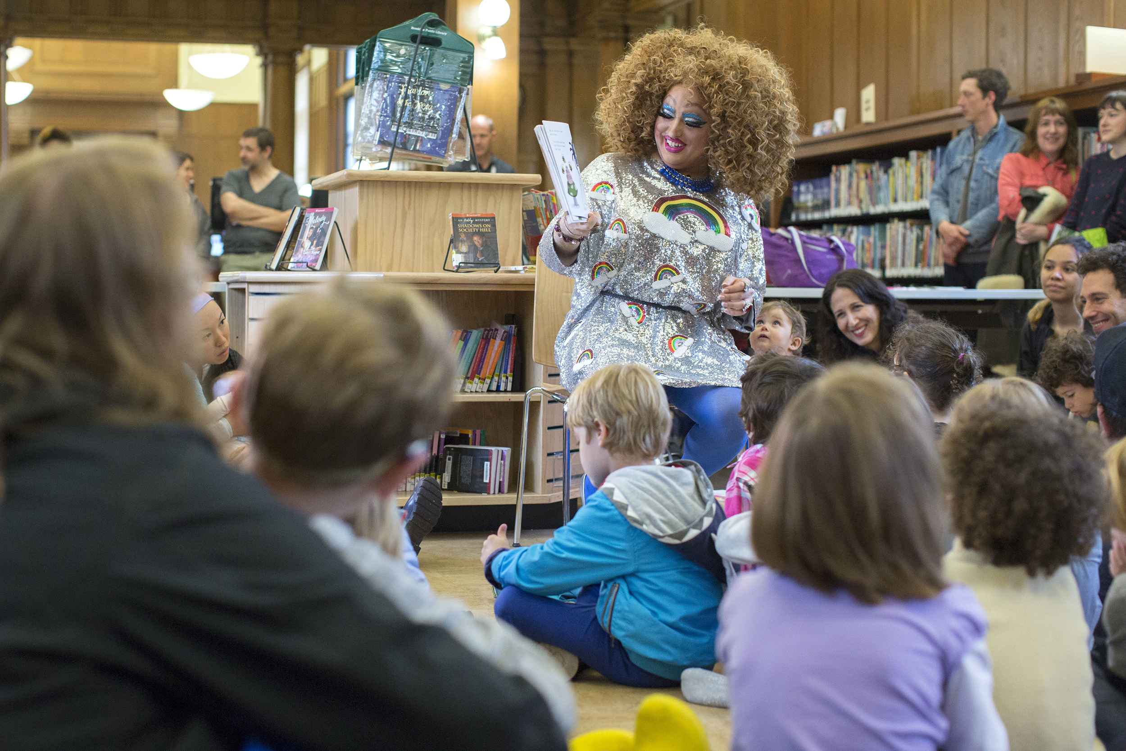

Slide 25
and that from childhood you have known the sacred writings which are able to give you the wisdom that leads to salvation through faith which is in Christ Jesus.
- II Timothy 3:15

Slide 26
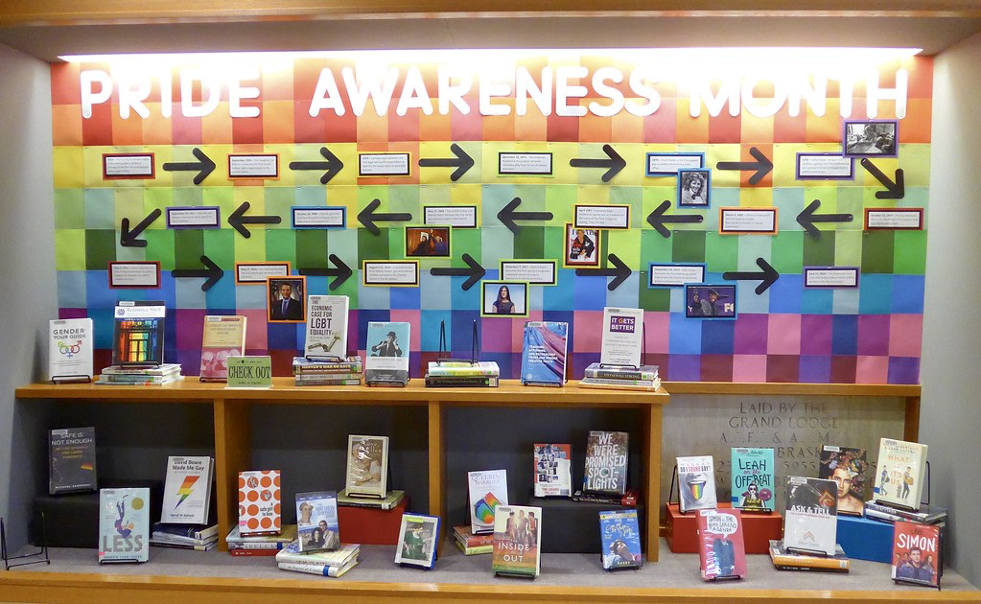
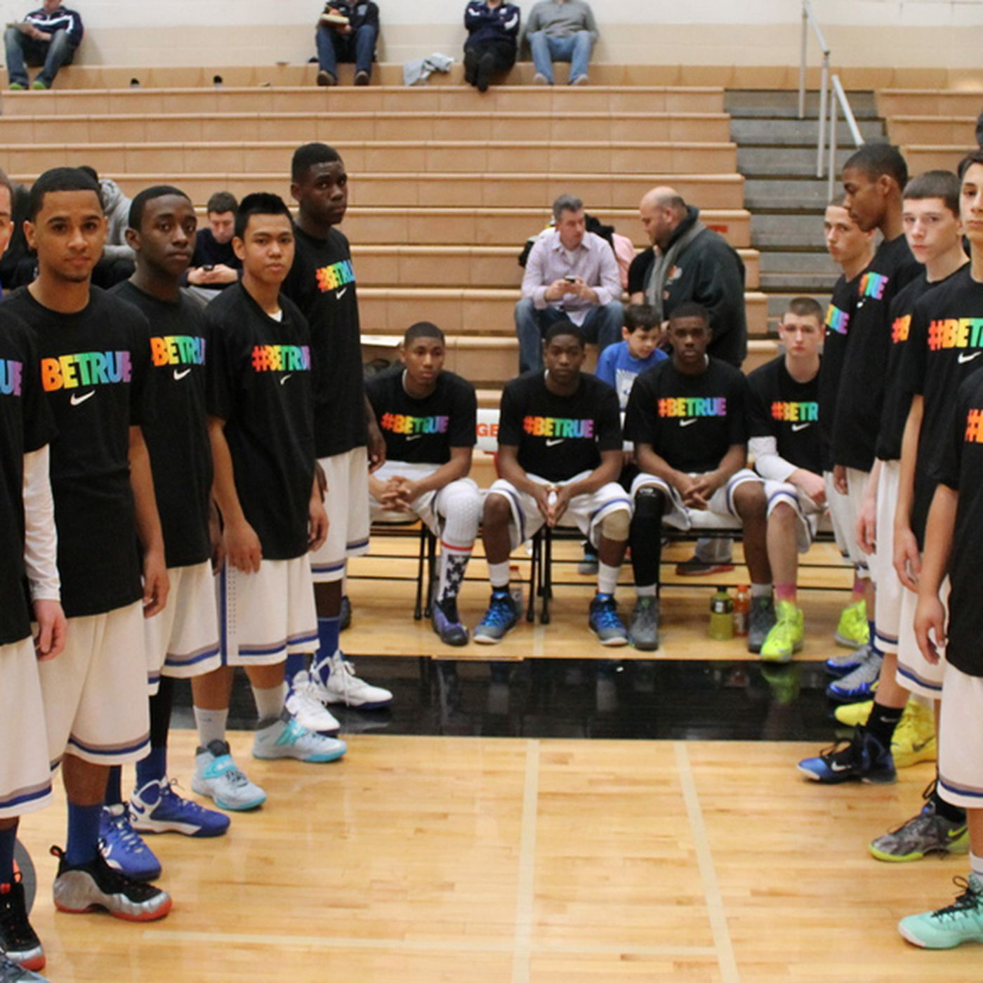
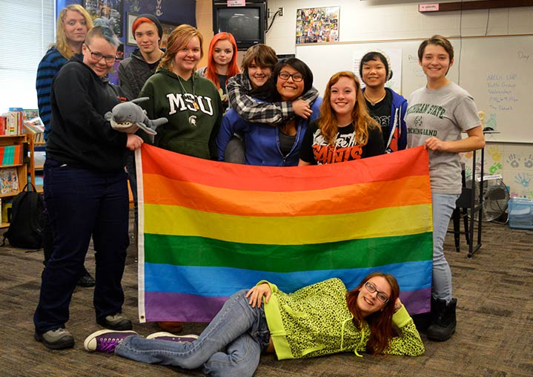

Slide 27
You shall not lie with a male as one lies with a female; it is an abomination.
- Leviticus 18:22

Slide 28
²⁶ For this reason God gave them over to degrading passions; for their women exchanged the natural function for that which is unnatural, ²⁷ and in the same way also the men abandoned the natural function of the woman and burned in their desire toward one another, men with men committing indecent acts and receiving in their own persons the due penalty of their error.
- Romans 1:26-27

Slide 29
⁹ Or do you not know that the unrighteous will not inherit the kingdom of God? Do not be deceived; neither fornicators, nor idolaters, nor adulterers, nor effeminate, nor homosexuals, ¹⁰ nor thieves, nor the covetous, nor drunkards, nor revilers, nor swindlers, will inherit the kingdom of God. ¹¹ Such were some of you; but you were washed, but you were sanctified, but you were justified in the name of the Lord Jesus Christ and in the Spirit of our God.
- I Corinthians 6:9-11

Slide 30
Who to believe? What do we do as Christians?

Slide 31
What Awakeism Does:
Stay close to God.
Make sure that your character is free from the love of money, being content with what you have; for He Himself has said, “I will never desert you, nor will I ever forsake you,” so that we confidently say, “The Lord is my helper, I will not be afraid. What will man do to me?” - Hebrews 13:5-6

Slide 32
Kids don’t grow up doing what you say they grow up and do what you do.

Slide 33
What Awakeism Does:
2. Stay close to the Bible
and that from childhood you have known the sacred writings which are able to give you the wisdom that leads to salvation through faith which is in Christ Jesus. All Scripture is inspired by God and profitable for teaching, for reproof, for correction, for training in righteousness; - II Timothy 3:15-16

Slide 34
¹⁰ Finally, be strong in the Lord and in the strength of His might. ¹¹ Put on the full armor of God, so that you will be able to stand firm against the schemes of the devil. ¹² For our struggle is not against flesh and blood, but against the rulers, against the powers, against the world forces of this darkness, against the spiritual forces of wickedness in the heavenly places.
- Ephesians 6:10-12

Slide 35
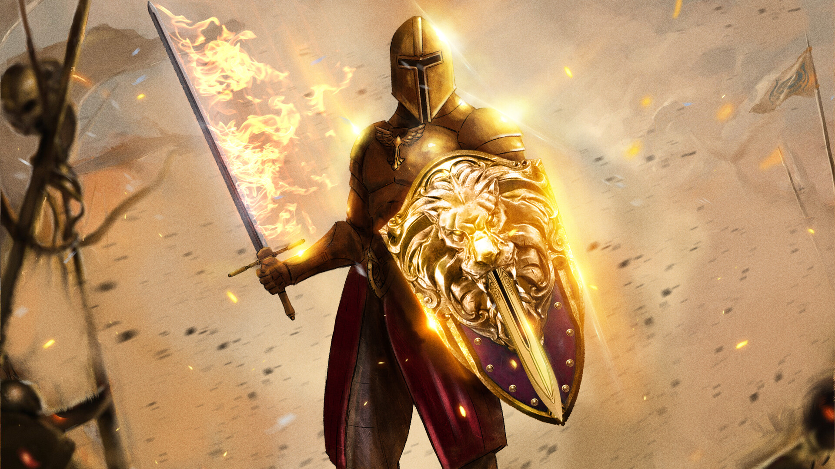
© TitanArt7

Slide 36
What Awakeism Does:
Stay close to God
Stay close to the Bible
Stay close to each other

Slide 37
⁹ Two are better than one because they have a good return for their labor. ¹⁰ For if either of them falls, the one will lift up his companion. But woe to the one who falls when there is not another to lift him up. ¹¹ Furthermore, if two lie down together they keep warm, but how can one be warm alone? ¹² And if one can overpower him who is alone, two can resist him. A cord of three strands is not quickly torn apart.
- Ecclesiastes 4:9-12

Slide 38
Christians:
Flock of sheep
Human body
Fellowship of believers

Slide 39
Awakeism’s Goals
Awake after death to Jesus’ welcome.
Matthew 25:13

Slide 40
Awakeism’s Goals
Awake after death to Jesus’ welcome
Be awake in this world when He suddenly appears.

Slide 41
¹⁶ For the Lord Himself will descend from heaven with a shout, with the voice of the archangel and with the trumpet of God, and the dead in Christ will rise first. ¹⁷ Then we who are alive and remain will be caught up together with them in the clouds to meet the Lord in the air, and so we shall always be with the Lord.
- I Thessalonians 4:16-17

Slide 42
Woke Lies:
Too simple
Too corny
Too churchy
Out of touch
Old fashioned
Part of the problem

Slide 43
Awake and Remember:
With just a few words:
God created light – Genesis 1:3
Raised the dead – Luke 7:11-17
Calmed a raging sea – Mark 4:35-44
Claimed victory over sin and death – John 19:30

Slide 44
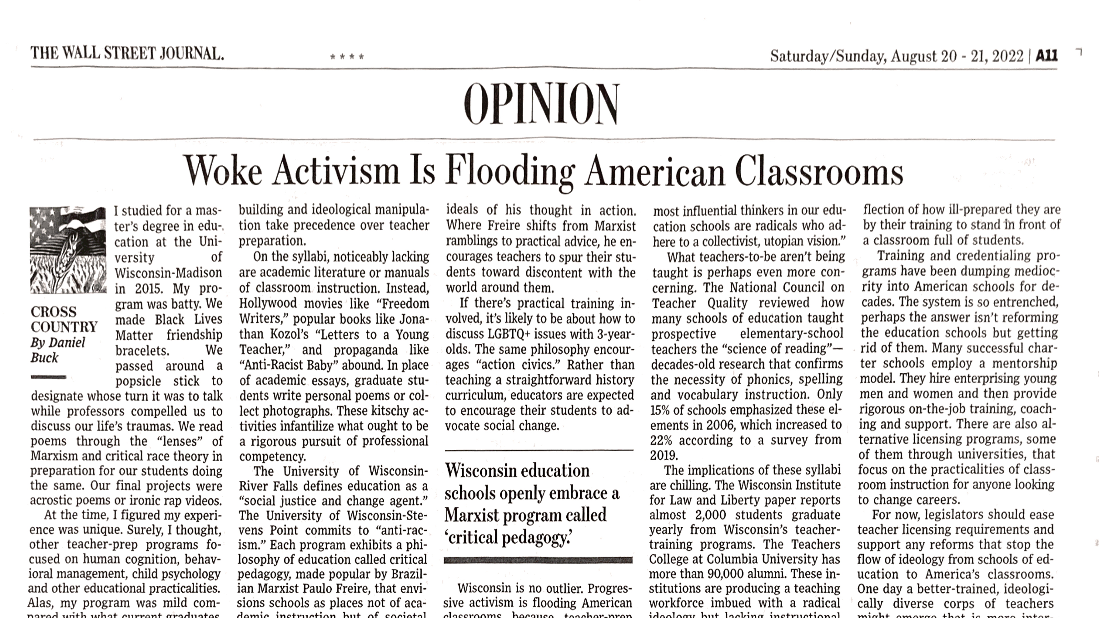

Slide 45
Invitation:
Awake from the sleep of disbelief
Awaken to the threat to your faith

